Slide 1
Chemistry 1215
General Chemistry I
Matter & Compounds, and Elements

Slide 2
Historical Antecedents

Slide 3
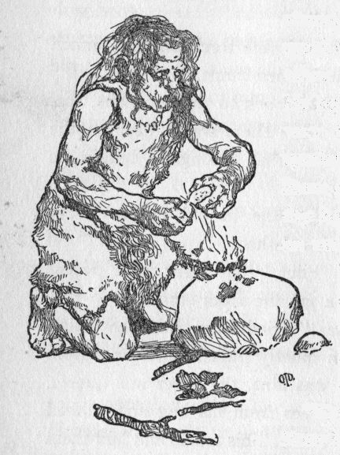
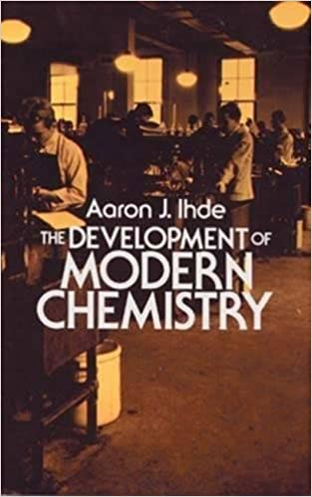
It may be argued that man has practiced chemistry from the time he learned to control fire.
Sinanthropus pekinensis, huddling in his caves near Choukoutein a half million years ago, left
an accumulation of ashes, charcoal and charred bones testifying to his use of fire. It would be
foolhardy to consider him a chemist in any more than the vaguest sense, for he undoubtedly
used fire more for warmth and protection from wild animals than for transformation of matter.
He was a fire-tender rather than a fire-maker. Only with the latter advance did primitive man
reach the point where he was truly able to control fire and to go on to use it effectively
in cooking, pottery-making and metal smelting, all of them involved in early chemical arts.
The Development of Modern Chemistry
Aaron J. Ihde
www.Gutenberg.org

Slide 4
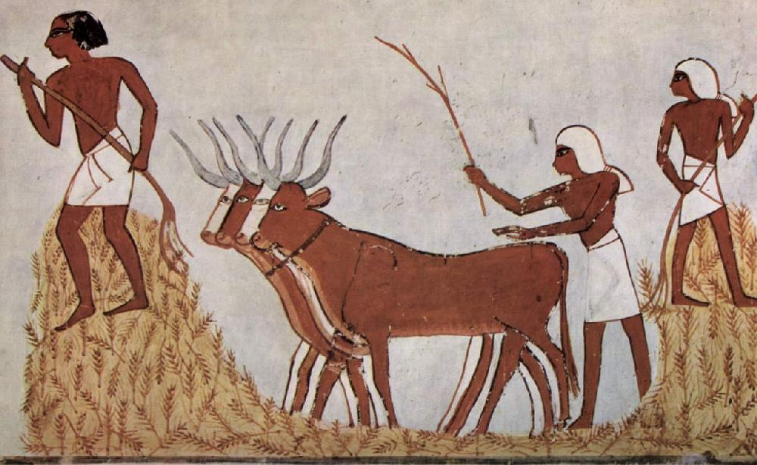
Technological Knowledge of Chemistry
Paleolithic Man
Roasting of Meats
Neolithic Revolution (12000 yrs ago)
Baking Pottery
Smelting of Copper (mp = 1085ºC)
Beer & Wine Making
Tanning of Leather
Scouring of Wool
Dyeing Textiles
Glass Making
Bronze Age (1200 BC)
Smelting of Tin (mp = 232ºC) & Lead
Alloying Copper with Tin & Arsenic
Iron Age
Smelting of Iron (mp = 1538ºC)
Steel Production (0.30 – 1.2% Carbon)

Slide 5
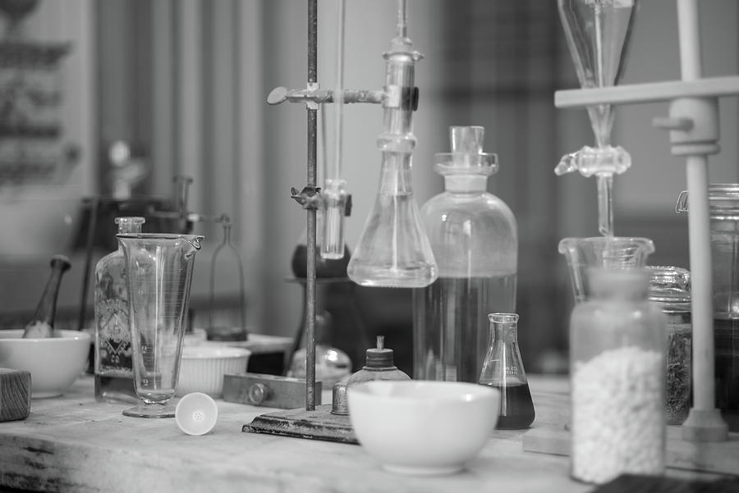
General Chemistry
What are the questions the science of chemistry seeks to answer, generally?

Slide 6
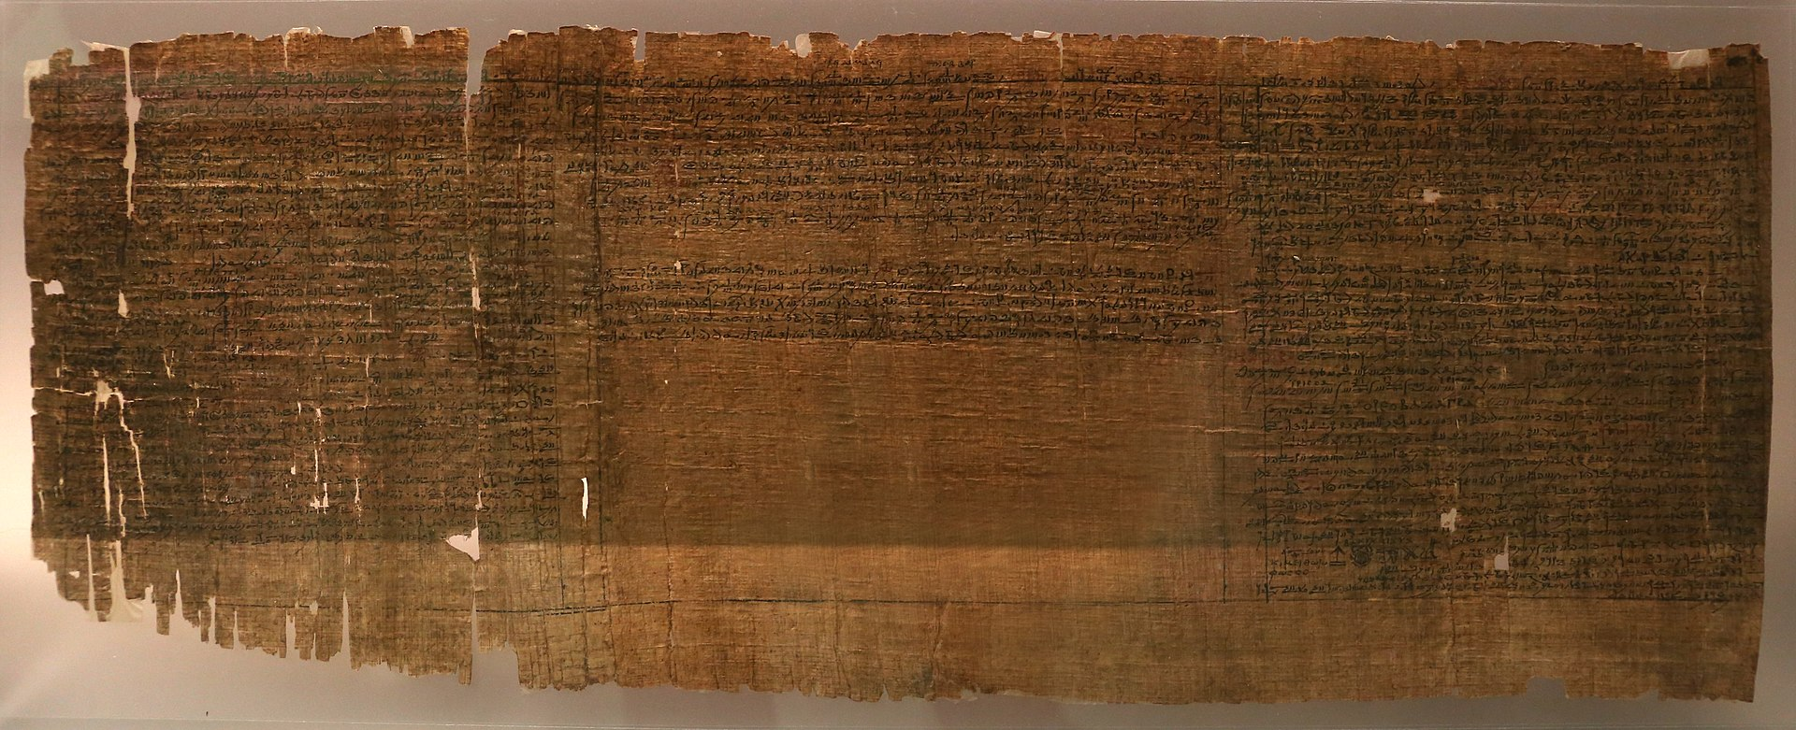
Earliest Alchemical Manuscripts
Leyden Papyrus X
Third Century AD
Leyden & Stockholm Papyri
Discovered at Thebes in Egypt.
Contain Recipes for False Silver, Gold, and Gems.
English Translation at E.R. Caley, J. Chem. Educ., 3, 1149 (1926) and 4, 979 (1927).

Slide 7
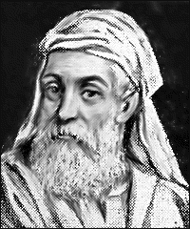
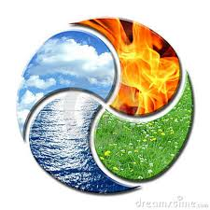
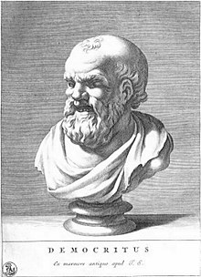
Greek Philosophical Thoughts
Empedocles (495 – 435BC)
Elemental Substances
Fire
Air
Change By Loss/Gain of Properties
By Action of Forces Love/Strife
Earth
Water
Democritus (460 – 370BC)
Atomist (Atoms Moving in a Void)
Solid & Homogeneous
Inherent Motion
Finite Number of Kinds
Speculative

Slide 8
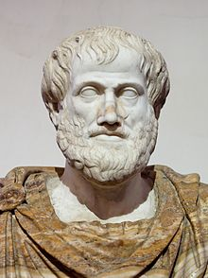
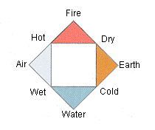
Aristotle (384 – 322BC)
Elements
Let us then define the element in bodies as that into which other bodies
may be analysed, which is present in them either potentially or actually
….. And which cannot itself be analysed into constituents differing in kind.
Aristotle
De caelo
Element Qualities
Hotness
Coldness
Dryness
Wetness
Wood is a compound substance, not a simple element. It is composed of a mixture of the four elements in specific proportions. When wood burns, you can see evidence of these elements being "exuded":
Transmutation
Add Hotness
Fire is evident in the Flames.
Air is released as Smoke,
Water can be Observes as Hissing Steam
Earth remains as Ash.
Earth Fire
Remove Coldness

Slide 9
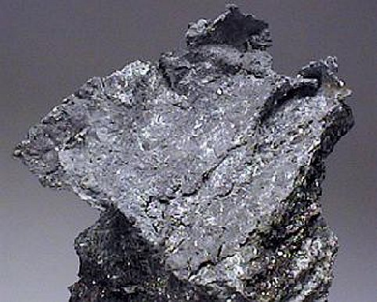
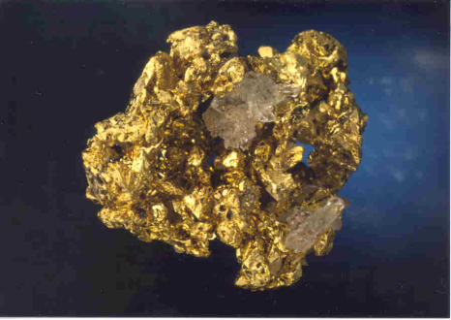
Alchemy
Base Metal Precious Metal
Lead (Plumbum)
Gold (Aurum)
If lead and gold both consist of fire, air, water, and earth, why may not the dull and common metal have the proportions of
its elements adjusted to those of the shinning, precious one?
The question is a reasonable one, but left the more difficult one – as to the method employable – unanswered.
Alchemy
E.J. Holmyard

Slide 10
I saw two seated leaning on each other, as pan is leaned against pan to warm, spotted from
head to foot with scabs; and never did I see currycomb plied by a boy for whom his lord is
waiting nor by one who keeps awake unwillingly; as each often plied the bite of his nails upon
himself, because of the great rage of his itching which has no other relief. And the nails
dragged down the scab, even as a knife the scales of bream or other fish that may have them
larger.
I began, …”So may memory of you not steal away in the first world from human minds, but
may live under many suns, tell me who ye are, and of what race; let not your disfiguring and
loathsome punishment fright you from disclosing yourselves unto me.”
“I was from Arezzo,” replied one of them, “and Albero of Siena had me put in the fire; but that
for which I died brings me not here. True it is that I said to him, speaking in jest, I knew how
to raise myself through the air in flight, and he, who had vain desire and little wit, wished that
I should show him the art, and only because I did not make him Daedalus, made me be
burned by one that held him as a son; but to the last pit of the ten, for the alchemy that
I practiced in the world, Minos, to whom it is not allowed to err, condemned me.”
Eighth Circle of Hell
The Divine Comedy by Dante Alighieri

Slide 11
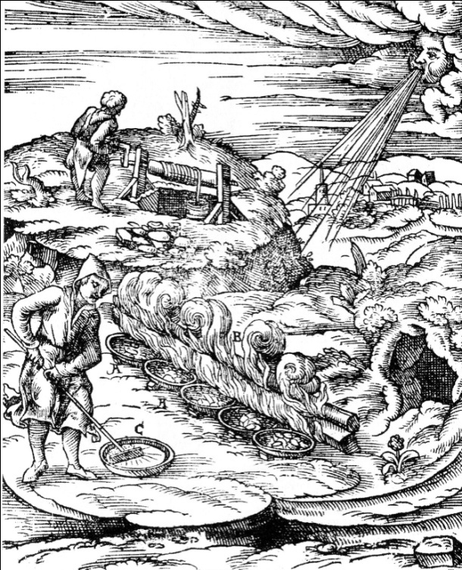
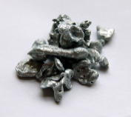
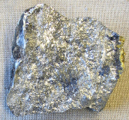
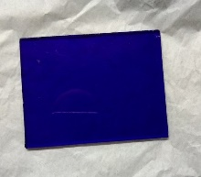
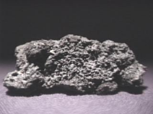
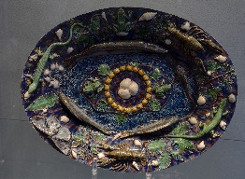
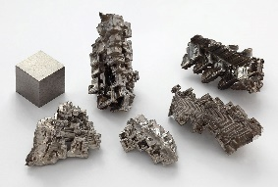
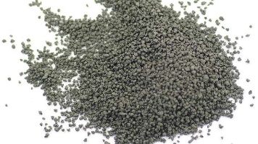
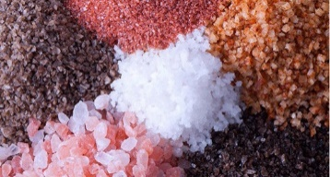
Recognition of Elemental Metals
Making Of
Zinc
Glass
Antimony
Indiamart.com
Co Blue Glass
Pottery
Arsenic
Bernard Palissy “Rusticware”
Bismuth
Glazes: Pb and Oxides of Cu, Co, Mn, Fe, Sn
Gunpowder
Smelting of Bismuth Ore
Brittanica.com
KNO₃, S, Charcoal
Salts & Acids
Awaken.com

Slide 12
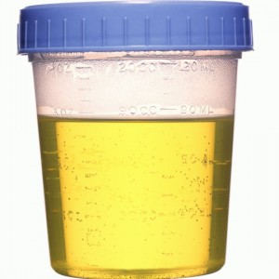
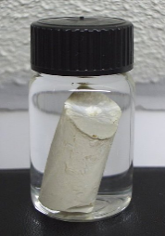
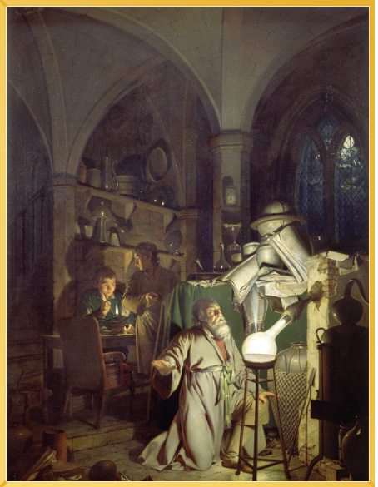
Discovery of Phosphorus
Boil to a Thick Mash
Urine White Phosphorus
Distill Hard
(Contains Phosphate, PO₄³⁻)
(Molecules of P₄)
The Alchymist Discovering Phosphorus, Joseph Wright

Slide 13
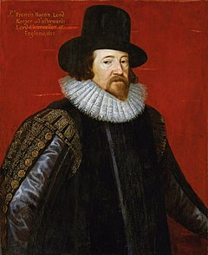
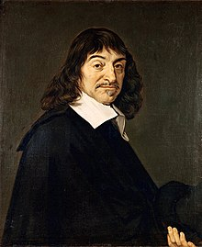
“Housecleaning”
Francis Bacon
(1561-1626)
Rene Descartes
(1596-1650)
Emphasis on Fact Collecting
Advocated Use of Inductive Reasoning
Science Should “endow human life with new inventions”
Principle of Systematic Doubt (Accept Nothing Not Established to be True
Experimentation Establishs Correctness

Slide 14
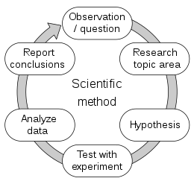
The Scientific Method
The scientific method is an empirical method of acquiring knowledge that has characterized the development of science since at least the 17th century.
It involves careful observation, applying rigorous skepticism about what is observed, given that cognitive assumptions can distort how one interprets the
observation. It involves formulating hypotheses, via induction, based on such observations; experimental and measurement-based testing of deductions
drawn from the hypotheses; and refinement (or elimination) of the hypotheses based on the experimental findings.
Wikipedia

Slide 15
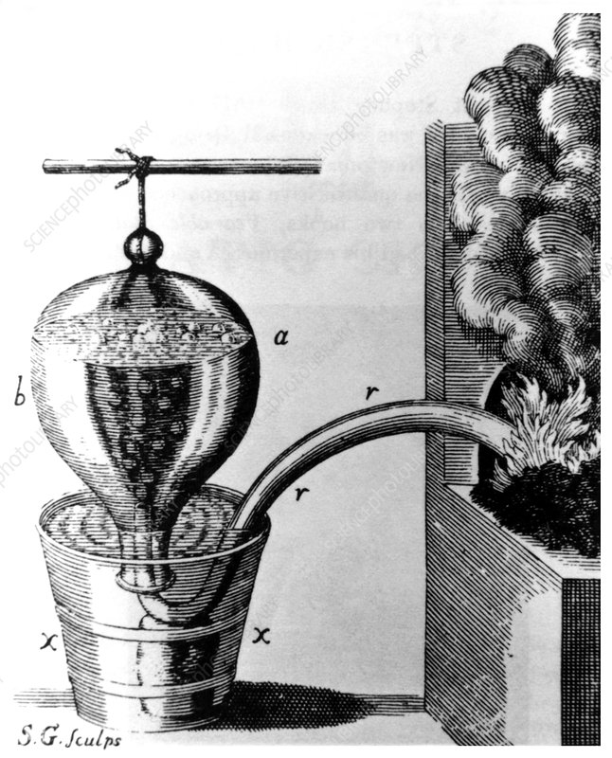
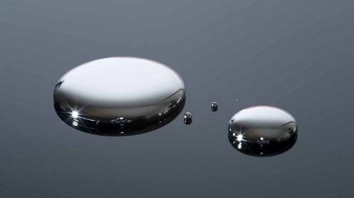
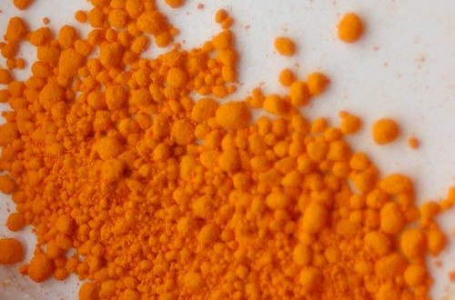
The Pneumatic Chemists
Study of Gases
Chemically Produced Gases Distinct from Air
Gases with Unique Properties
Air not an Element
Gases Combine with Liquids & Solids, “Composition of Matter is Fundamental”
Heat in the Presence
of Oxygen
Mercury
Heat in the Absence
of Oxygen
Red Calx of Mercury
Hale’s Pneumatic Trough for Collecting Gases

Slide 16
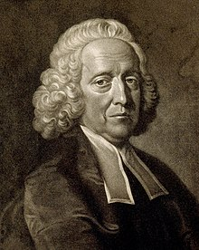
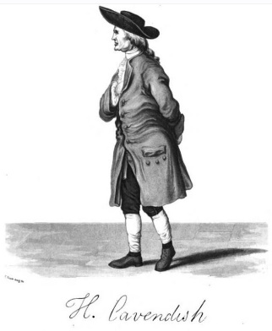
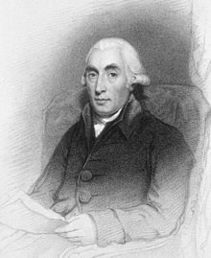
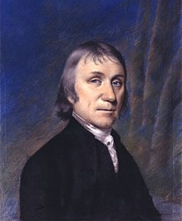
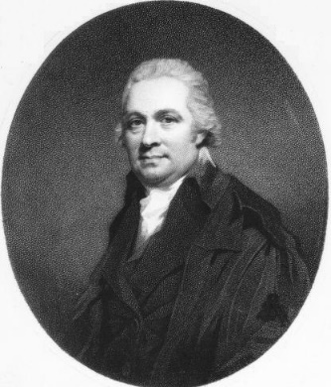
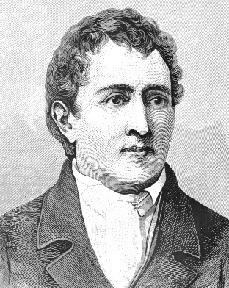
Stephen Hales
(1677 – 1761)
Henry Cavendish
(1731 – 1810)
Quantified Fixed Air (Carbon Dioxide)
Released During Heating Solid Substances
Isolated Inflammable Air (Hydrogen)
Joseph Black
(1728 – 1799)
Joseph Priestly
(1733 – 1804)
Isolated Oxygen
and
Nitrous Air (Nitric Oxide)
Dephlogisticated Nitrous Air (Nitrous Oxide)
Marine Acid Air (Hydrogen Chloride)
Alkaline Air (Ammonia)
Vitriolic Acid Air (Sulfur Dioxide)
Identified Fixed Air (Carbon Dioxide)
Daniel Rutherford
(1749 – 1819)
Carl Wlhelm Scheele
(1742 – 1786)
Identified Noxious Air (Nitrogen)
Isolated Oxygen

Slide 17
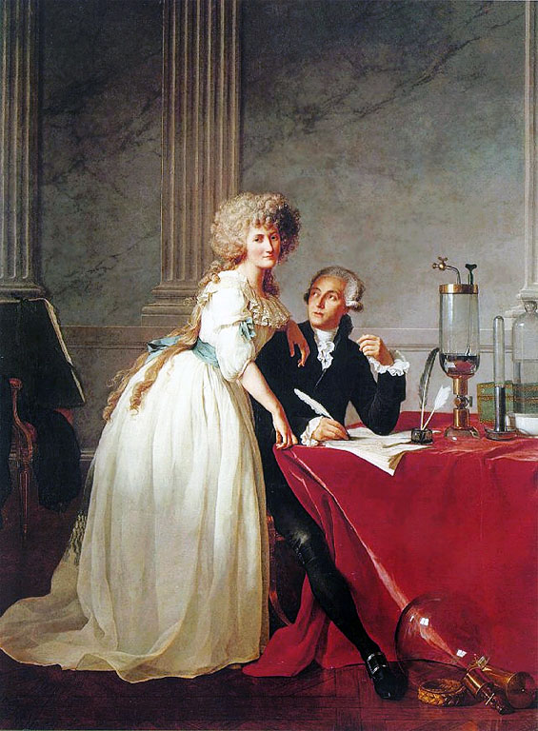
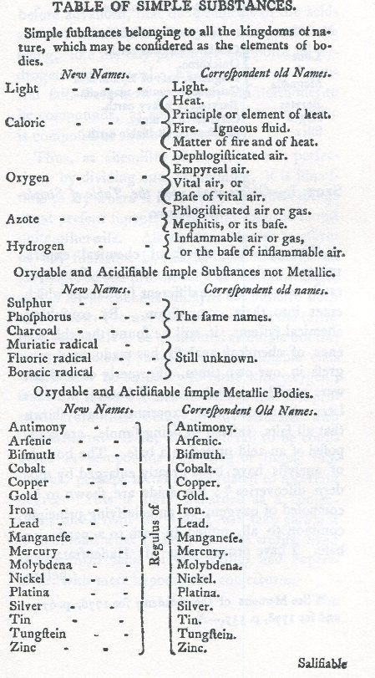
Antoine Lavoisier (1743 – 1794)
Father of Modern Chemistry
First Textbook of Chemistry
Discovered Compound Nature of Water
Listed the Elements
Extensive Studies of Respiration
Discovered Oxygen & Overthrew Theory of Phlogiston
Enunciated Law of Conservation of Mass
Helped Establish the Metric System
Portrait of Monsieur Lavoisier and his Wife By Jacques-Louis David

Slide 18
Properties and Classification of Matter

Slide 19
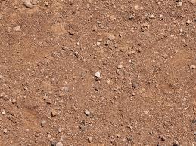
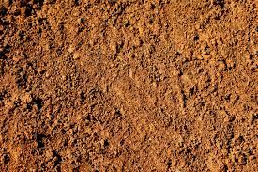
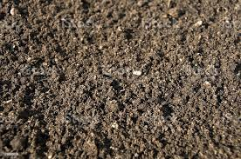
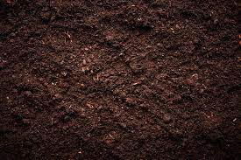
Earth?
Is There A Substance Called Earth?
Can These Samples Be Characterized?

Slide 20
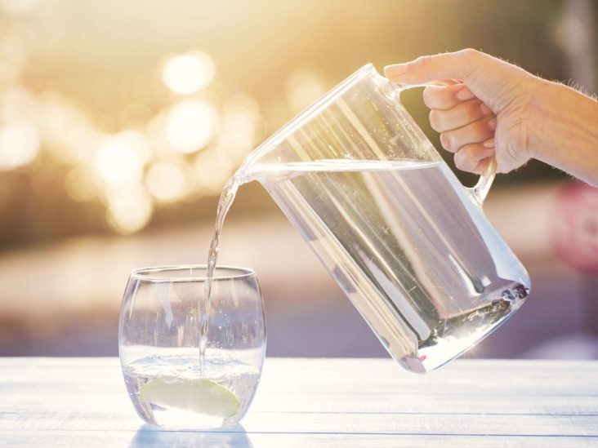
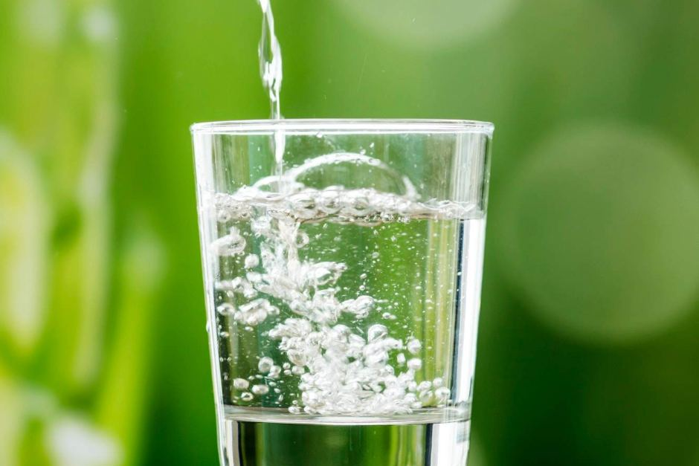
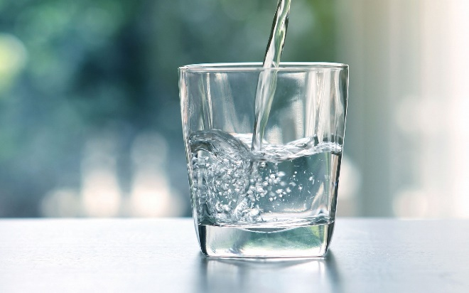
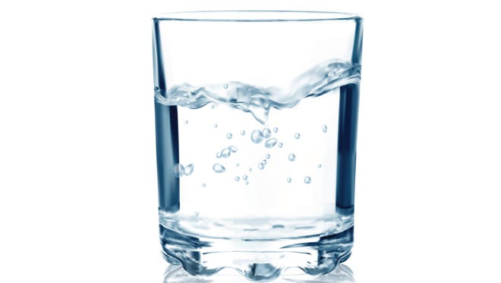
Water?
Is There A Substance Called Water?
Can These Samples Be Characterized?

Slide 21
Properties
Chemical
Physical

Slide 22
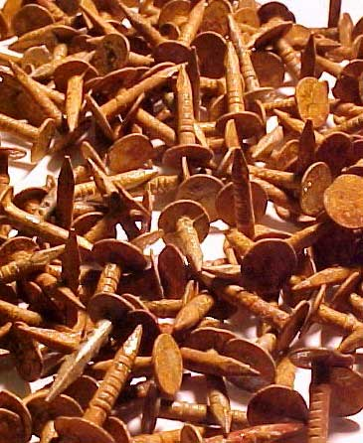
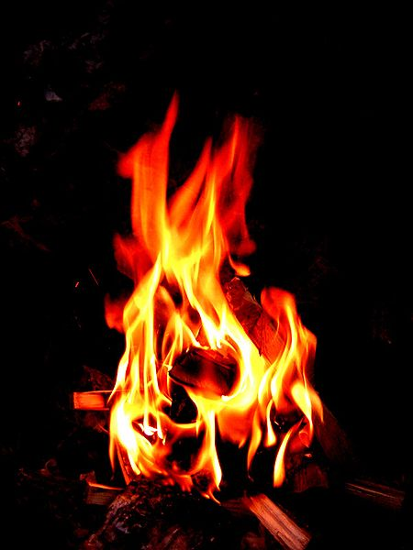
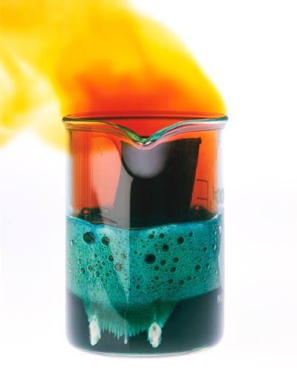
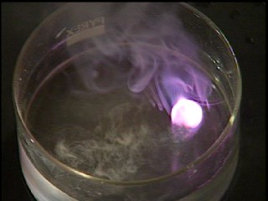
Processes
Examples of Chemical Processes
Rusting of Iron
Combustion of Wood in Air
Reaction of Nitric Acid and Copper
Reaction of Elemental Potassium in Water

Slide 23




Examples of Physical Processes
“Scratching” a Surface
Dissolving Table Salt in Water
Boiling of Water

Slide 24
Properties
Examples of Chemical Properties
Reactivity in Air
Reactivity in Air
Reactivity in Water
Reactivity in Concentrated Nitric Acid

Slide 25
Examples of Physical Properties
Mohs Hardness
Solubility
Boiling Point

Slide 26


Intensive vs. Extensive Physical Properties
Water Drop
Vol = 1 mL
Density = 1.0 g/mL
Glass of Water
Vol = 500 mL
Density = 1.0 g/mL
Water in Swimming Pool
Vol = 20000 gal
Density = 1.0 g/mL

Slide 27
Properties
Chemical
Physical
Intensive
Extensive

Slide 28


Examples
Malachite
color = Dark Green
mp = 200ºC
bp = 260ºC w/ decomp
density = 4.0 g/cm³
Mohs hardness = 35. – 4
Insoluble in Water
Water
Hydrogen Peroxide
color = transparent
mp = 0ºC
bp = 100ºC
Density = 1.0 g/mL
color = translucent light blue
slightly viscous
mp = -0.43ºC
bp = 150.2ºC w/ decomp
density = 1.450 g/mL
Miscible with Water

Slide 29







Classification of Matter
Brass
Granite
Ice-Water
Salt Water
Milk
Oil-Water
Air

Slide 30


Heterogeneous Mixtures
Heterogeneous Systems
Phase
A system with multiple phases.
A region that is uniform in its properties throughout.
Homogeneous Systems
A single phase system.

Slide 31
2 Phases
2 Phases
3 Phases

Slide 32





Phase Types
Gas
Liquid
Solid
Bose Einstein Condensate
Plasma

Slide 33


Solutions
Solution
A homogeneous, multi-component system.
Pure Compound
A homogeneous, single component system.

Slide 35


Properties of Aqueous Ethylene Glycol Solutions
wt% Freezing Pt. [ºC] Density [g/mL] Viscosity [mPa sec]
0.0 0.00 0.99821 1.002
0.5 -0.15 0.9988 1.010
1.0 -0.30 0.9995 1.020
2.0 -0.61 1.0007 1.048
3.0 -0.92 1.0019 1.074
4.0 -1.24 1.0032 1.099
5.0 -1.58 1.0044 1.125
6.0 -1.91 1.0057 1.153

Slide 36
Separations

Slide 37
Analyze the Following Systems
What Compounds & Elements Comprise these Systems?
What is the Elemental Composition of the Compounds?
How can the System be Prepared from its Constituent Compounds/Elements?

Slide 38



Filtration
Filtrum
Antoine Lavoisier
First to Use Paper Filters
Jons Jacob Berzelius
Very Pure Absorbant Paper
1810
J.H. Munktells Manufactured

Slide 39





Slide 40

Separatory Funnel

Slide 41



Distillation
Alcohol: bp = 78.5ºC
Water: bp = 100ºC
wine
brandy

Slide 42



Vigreux Column
Simple Distillation
Fractional Distillation

Slide 43





Steam Distillation
Peppermint Oil
Oil of Wintergreen
Lavender Oil

Slide 44


Distilled Spirits

Slide 45
Distilled Spirit | Ferment | Notes
Brandy | Grapes, apple, pear | Distilled Wine (Cognac is double distilled in a pot still)
Whisky | Barley, malted barley, rye, wheat, corn | Distilled and Aged in a Wooden Cask
Bourbon | Mash greater than 51% maize | Distilled and Aged in New, Charred Oak Cask (Straight Bourbon is aged at least 2 years)
Gin | Grapes, sugar beets, sugarcane | Neutral Grain Spirit with Juniper Berries added and Redistilled
Vodka | Grain, potatoes, molasses | Multiply Distilled

Slide 46


Crude Oil Refining
Medium Heavy Crude

Slide 47


Slide 48

Fraction | # C’s | BP Range
Natural Gas | 1 - 4 | Below 20
Petroleum Ether | 5 – 6 | 30 – 60
Ligroin | 7 | 60 – 90
Straight-Run Gasoline | 6 - 12 | 85 – 200
Kerosene | 12 - 15 | 200 – 300
Fuel Oil | 15 - 18 | 300 – 400
Lubricating Oil Paraffin Wax Asphalt | 16 - 24 | Above 400

Slide 49




Chromatography
Mikhail Tsvet

Slide 50

How Chromatography Works

Slide 51


Paper Chromatography
Chromatogram of Several Inks

Slide 52


Thin Layer Chromatography
TLC Chromatogram of an Ink

Slide 53

Column Chromatography

Slide 54


Slide 55
“Pure” Substance: Can be either Compound or Elemental
Compound: Can be broken-down by standard chemical and physical methods
Let us then define the element in bodies as that into which other bodies
may be analysed, which is present in them either potentially or actually
….. And which cannot itself be analysed into constituents differing in kind.
Aristotle
De caelo

Slide 56
Compounds and Elements

Slide 57



Fire
Earth
Air
Water

Slide 58


Base Metal Precious Metal
Lead (Plumbum)
Gold (Aurum)
Aristotle next argues that each and every other substance is composed of each and every ‘element’, the difference between
one substance and another depending on the proportions in which the elements are present. The kind of reasoning on which
this proposition is based may be followed by observing what happens when a piece of green wood is heated; drops of water
form at the cut end of the wood, therefore wood contains water; steam and vapours are given off, therefore wood contains
air; the wood burns, therefore it contains fire; and an ash is left, therefore wood contains erarth.
If lead and gold both consist of fire, air, water, and earth, why may not the dull and common metal have the proportions of
its elements adjusted to those of the shinning, precious one?
The question is a reasonable one, but left the more difficult one – as to the method employable – unanswered.
Alchemy
E.J. Holmyard

Slide 59




Lead Oxide
Lead (Plumbum)
Lead Sulfide
Lead (Plumbum)
Lead Carbonate
Lead (Plumbum)
Compounds
Element

Slide 60

Compound Nature of Water
Lavoisier’s Demonstration of the Compound Nature of Water
Water Hydrogen + Oxygen
Oxygen + Iron Iron Oxide

Slide 61
Lavoisier’s Experiments with Mercury
Composition of the Compound Red Calx of Mercury
Heat in the Presence
of Oxygen
Mercury
Heat in the Absence
of Oxygen
Red Calx of Mercury

Slide 62








Elements Known to the Ancients
Carbon
Sulfur
Iron
Tin
Lead
Copper
Mercury
Silver
Gold

Slide 63




Elements Discovered by Metallurgists
Arsenic
Antimony
Bismuth
Zinc

Slide 64

The Elements
Elements of Chemistry
By Antoine Lavoisier
Portrait of Monsieur Lavoisier and his Wife By Jacques-Louis David

Slide 65


Slide 66





Allotropes
Carbon
Graphite
Diamond
Buckminsterfullerene
Pyrolysis of Aromatic Hydrocarbons
Phosphorus
White Phosphorus
Red Phosphorus

Slide 67


Metals, etc.
Lustrous
Malleable or Ductile
Conduct Electricity & Heat
Aluminum = Metal
Silicon = Metalloid
Phosphorus = non-Metal

Slide 68


Slide 69





Physical State

Slide 70





Properties of the Alkali Metals
Element | At. Weight | mp (ºC) | D (g/mL) | Oxide | Chloride
Lithium | 7 | 180 | 0.534 | Li₂O | LiCl
Sodium | 23 | 98 | 0.968 | Na₂O | NaCl
Potassium | 40 | 63 | 0.89 | K₂O | RbCl
Rubidium | 86 | 39 | 1.53 | Rb₂O | RbCl
Cesium | 133 | 28 | 1.93 | Cs₂O | CsCl
Lithium Sodium Potassium Rubidium Cesium
Cesium in Water
http://www.youtube.com/watch?v=sNdijknRxfU
http://video.google.com/videoplay?docid=-2134266654801392897

Slide 71





Properties of the Alkaline Earths
Element | At. Weight | mp (ºC) | D (g/mL) | Oxide | Chloride
Beryllium | 9 | 1287 | 1.85 | BeO | BeCl₂
Magnesium | 24 | 650 | 1.738 | MgO | MgCl₂
Calcium | 40 | 842 | 1.55 | CaO | CaCl₂
Barium | 137 | 727 | 3.51 | BaO | BaCl₂
Radium | (226) | 700 | 5.5 | RaO | RaCl₂
Beryllium Magnesium Calcium Barium Radium

